Slide 1



Final Project - 放心出行
Group
Group Member :
WAN Ka Chuen
LAM Tsz Ho
HUNG Ho Him
HUNG Wai Chun
TANG Lik Pan

Slide 2
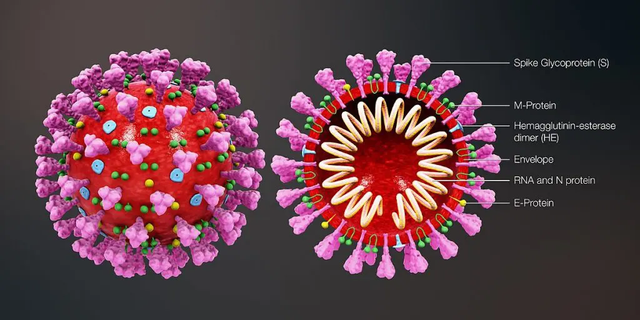
Introduction - background
Our aim is to provide a service that allow people to record the places that they have been to, and we will notify them if there is any sick patient been to the same place that they have been to.

Slide 3
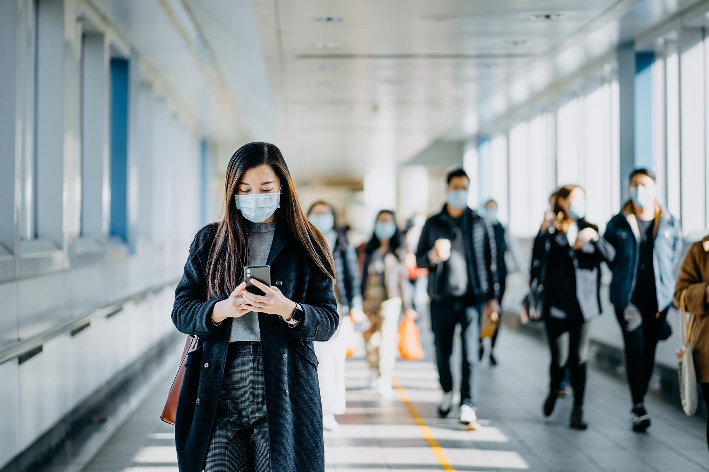
Introduction - target user
Our target users are mainly ordinary people. Our plan will reduce the function so that the elderly can use it, and implement the effect of epidemic prevention.

Slide 4
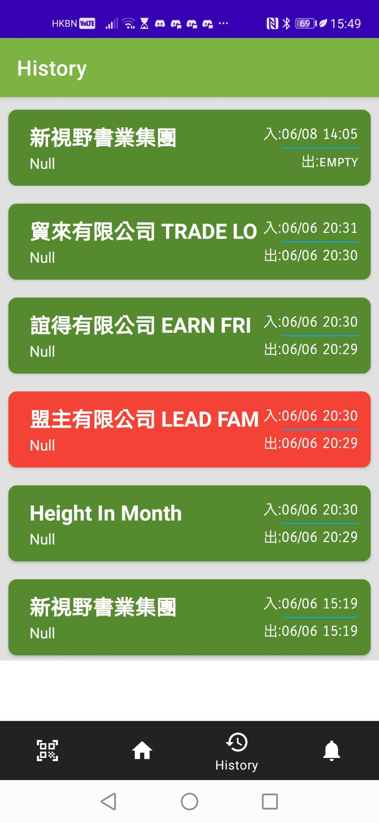

Introduction - functions
Record place visited
Report confirmed positive or preliminary positive
Receive exposure notification
Receive the latest disease prevention measures
Details of case

Slide 5
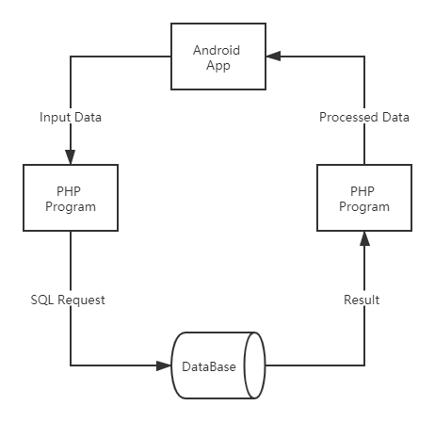
Platform & Flowchart
Our application base on Android Java.Why we will choose Android as our develop platform since it is a open source operating system and it is more friendly for developers we can found a lot of develop document from the internet so it will make us easily to coding a program we want.
We using php(7.4) language to process the input data.
Using MySQL DataBase to storing the input data and user data

Slide 6
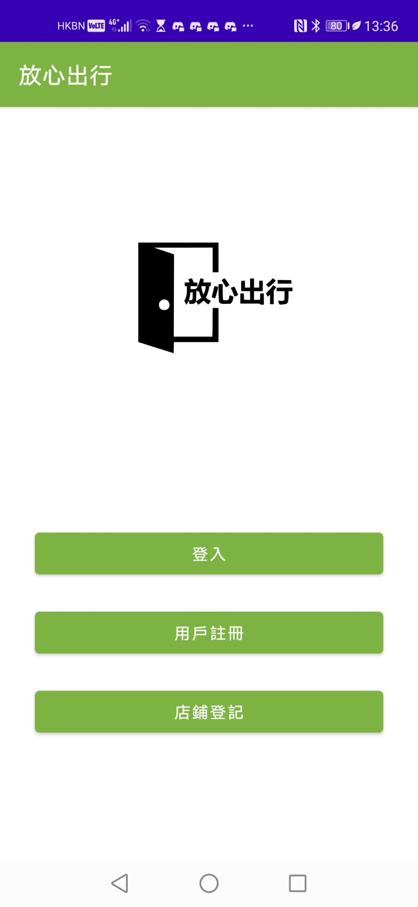
login page
registration page (Person)
registration page(Company)

Slide 7
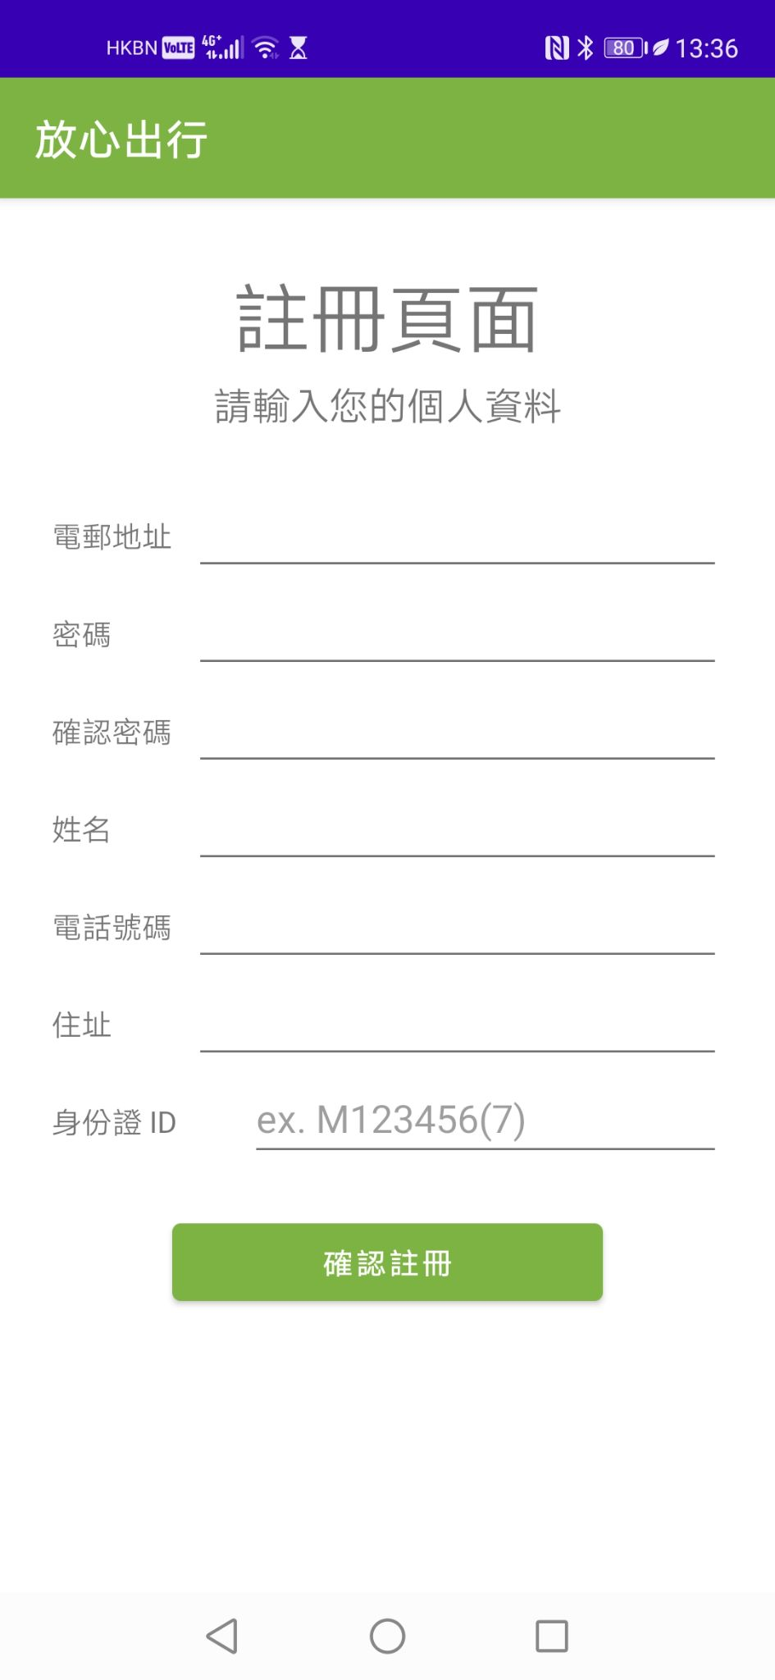

Slide 8
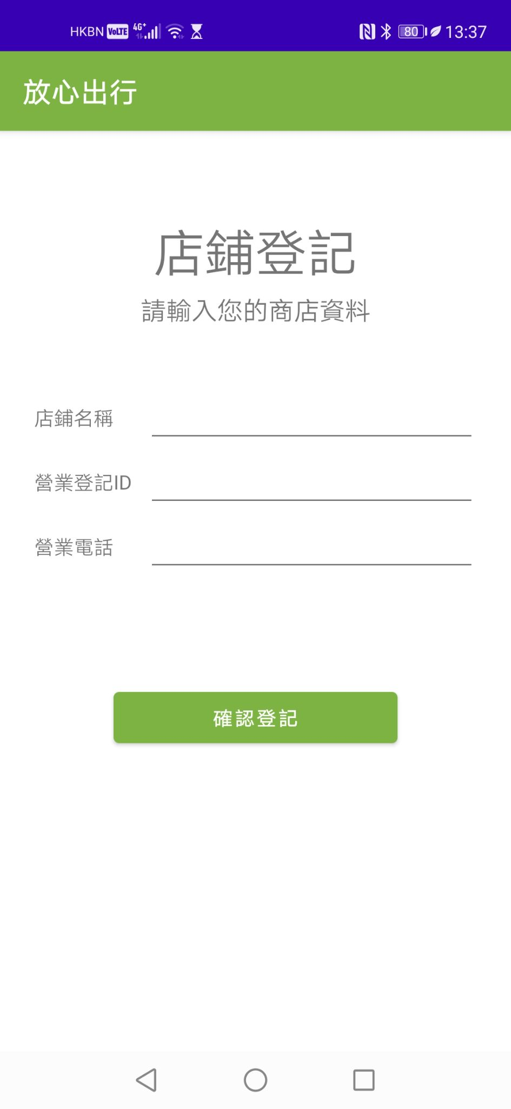

Slide 9
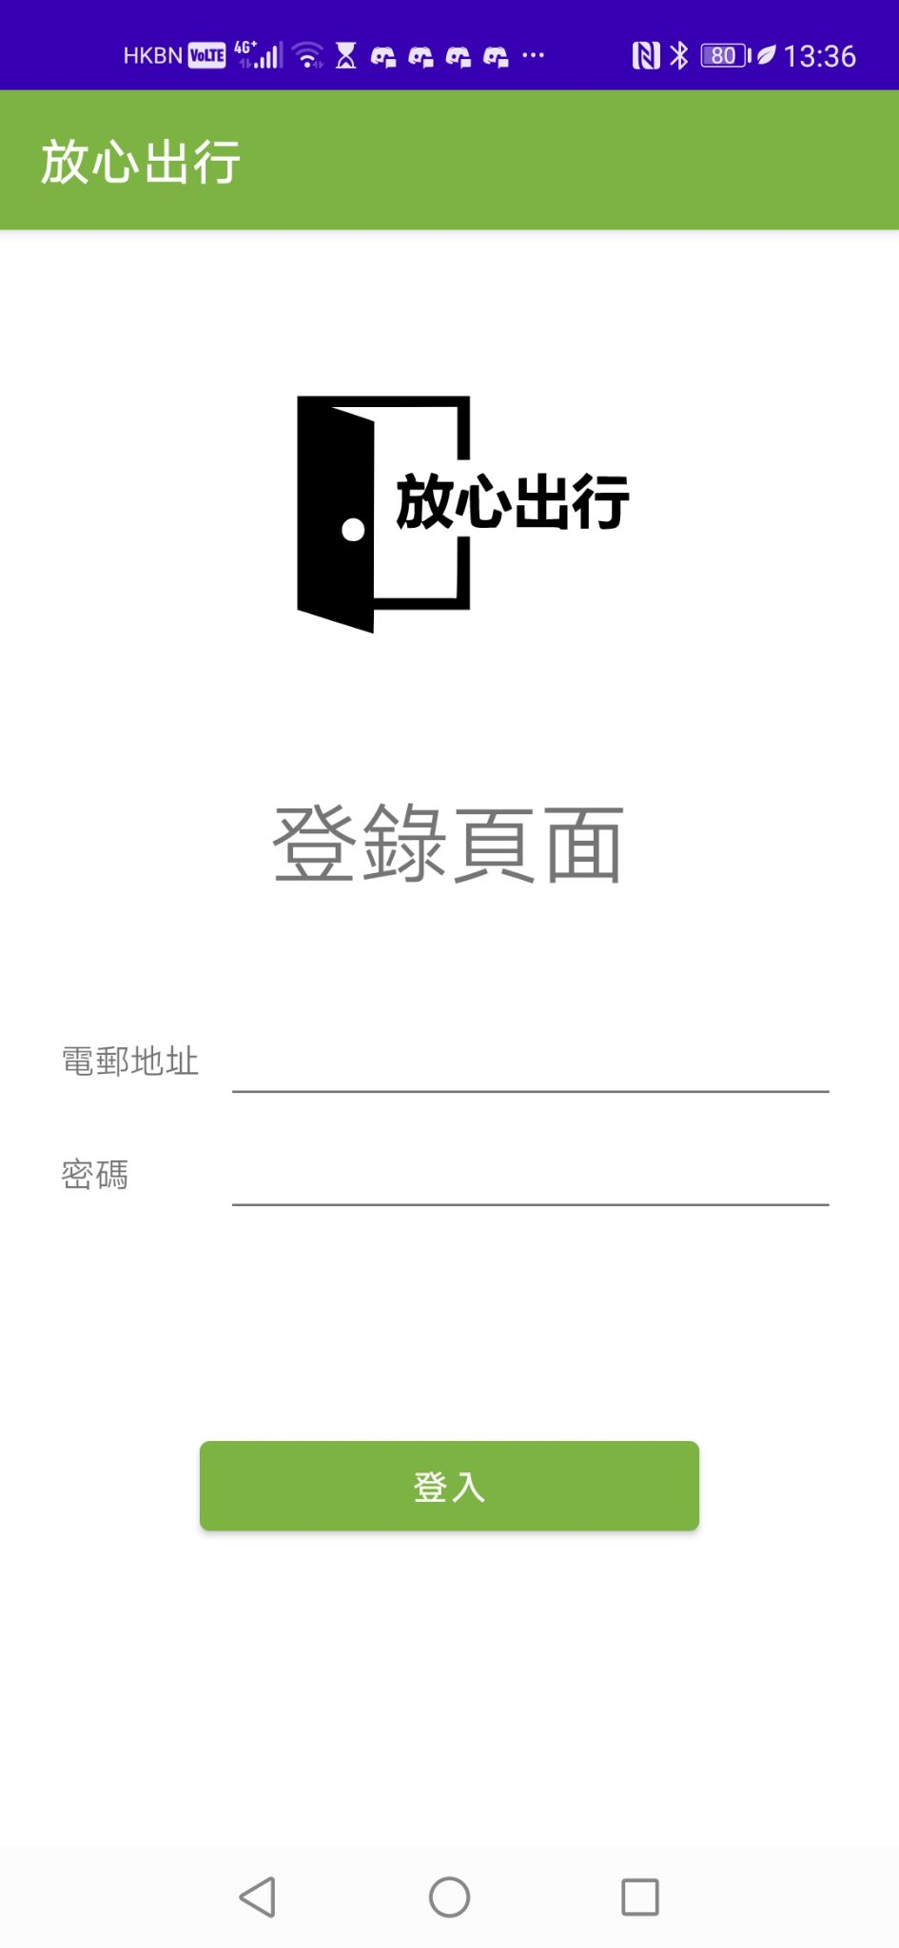

Slide 10
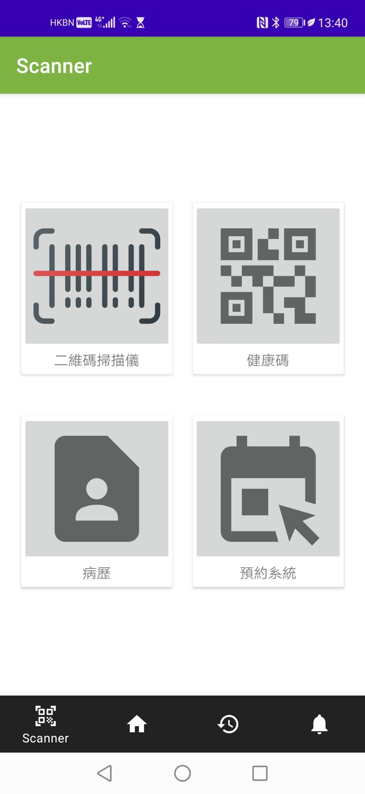
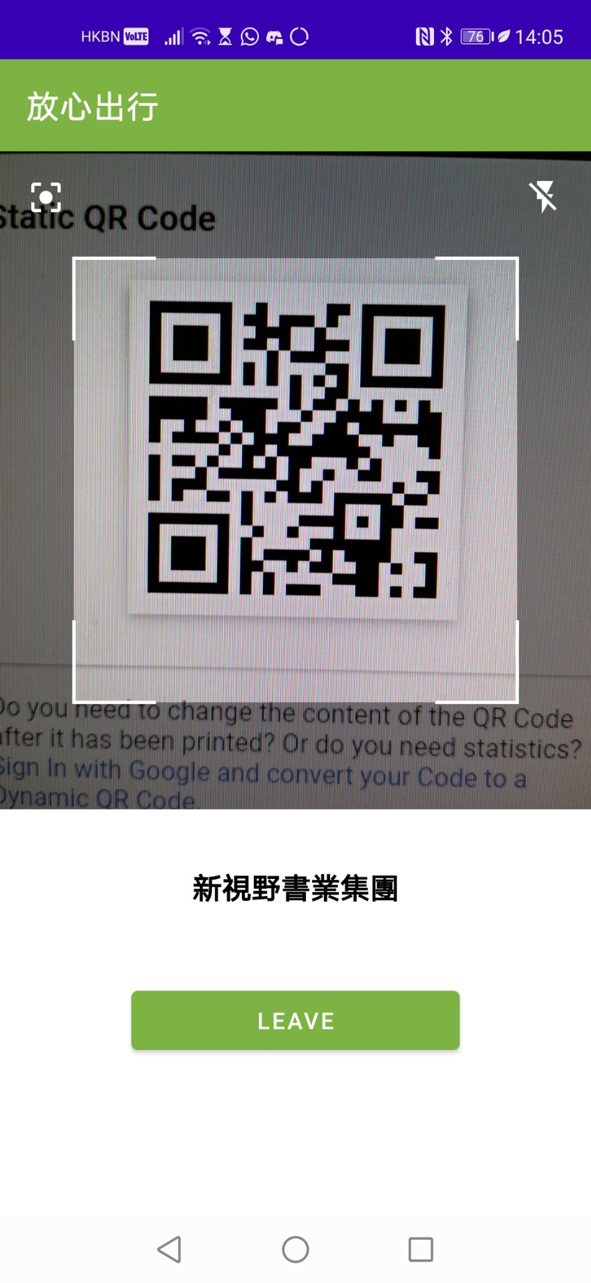
user side

Slide 11
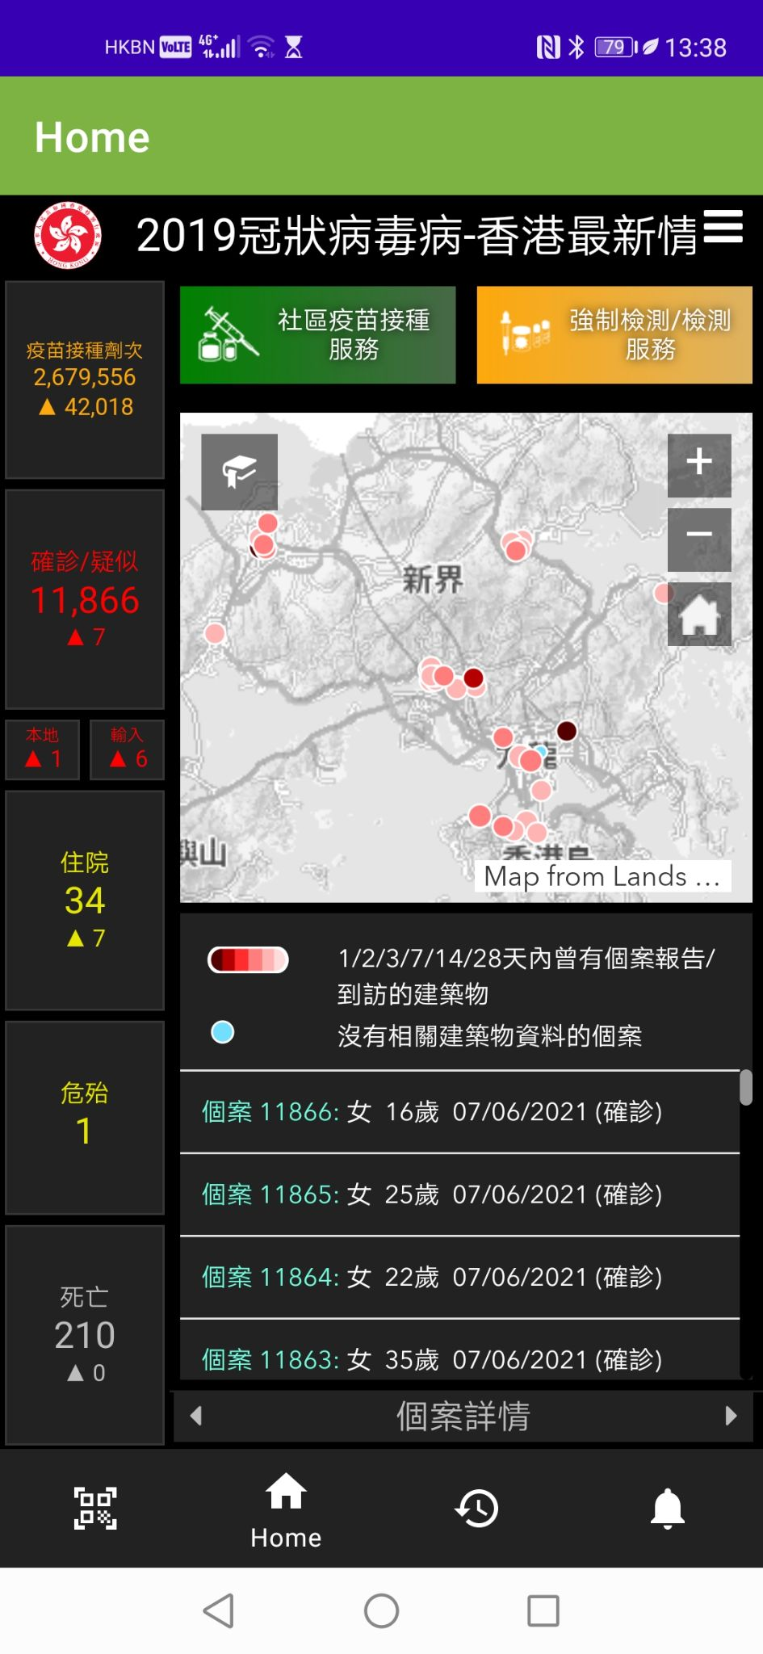
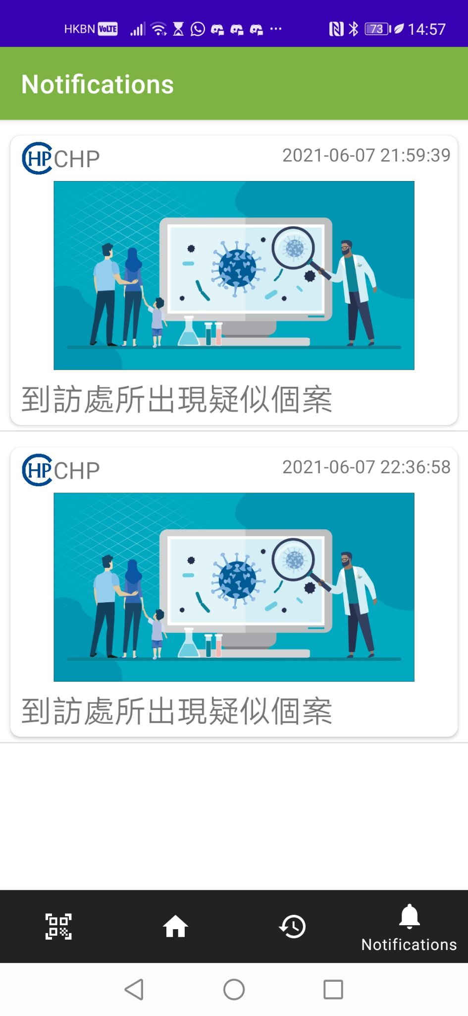

Slide 12
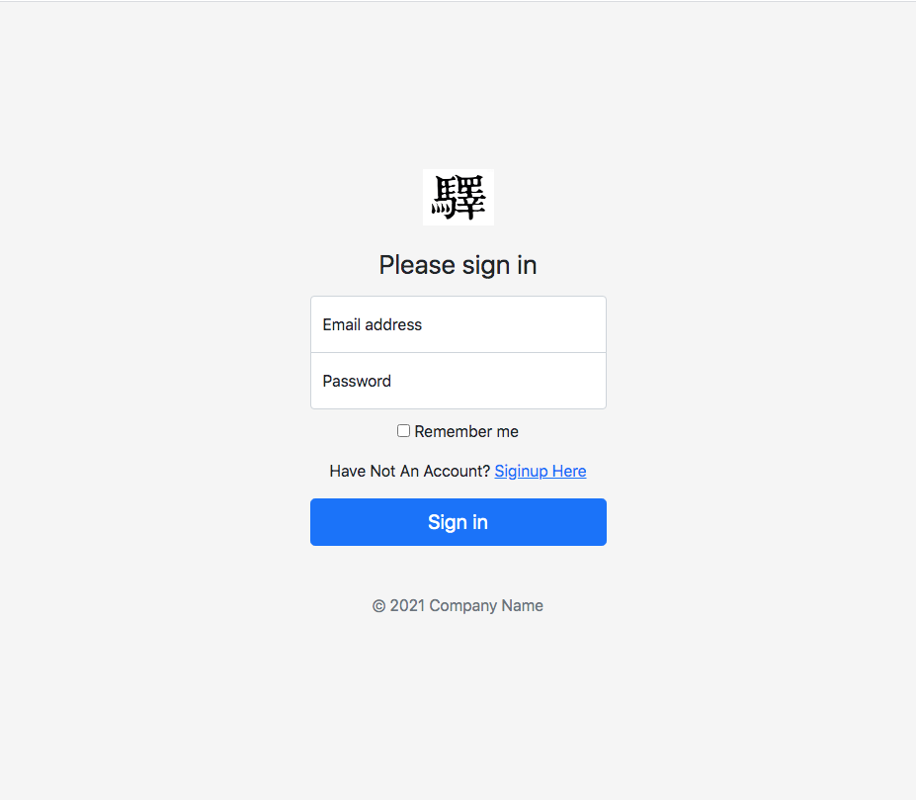
Admin
Side

Slide 13
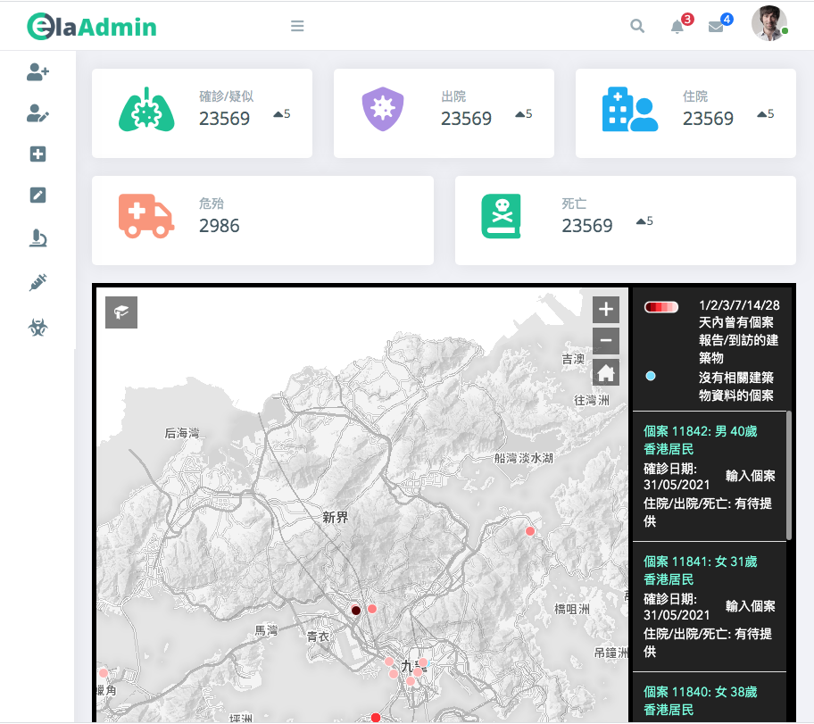

Slide 14
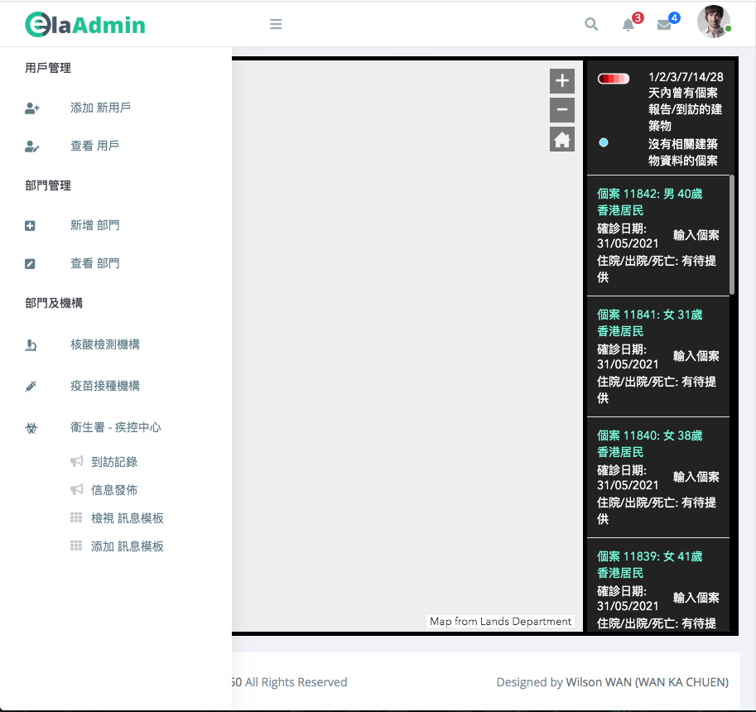

Slide 15
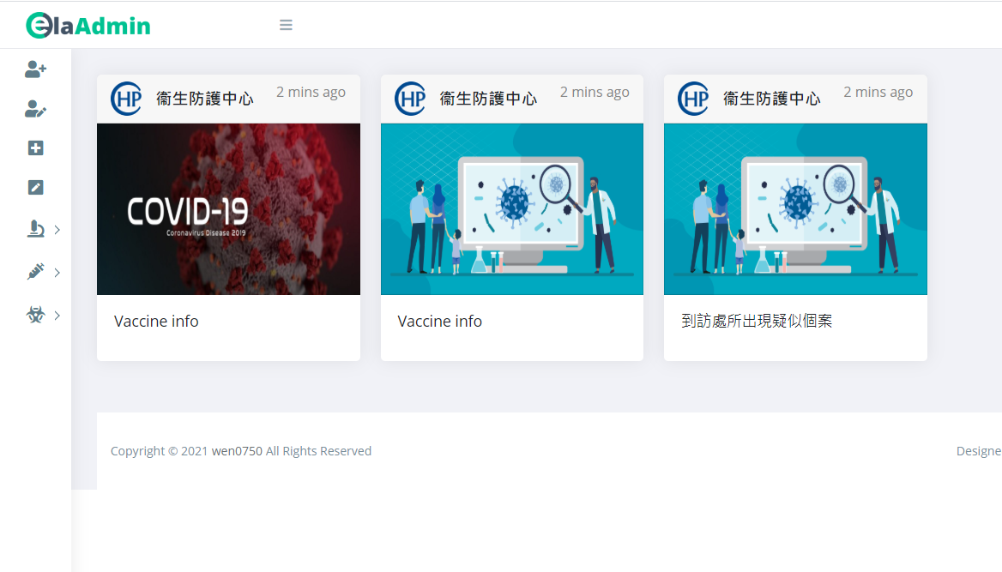

Slide 16
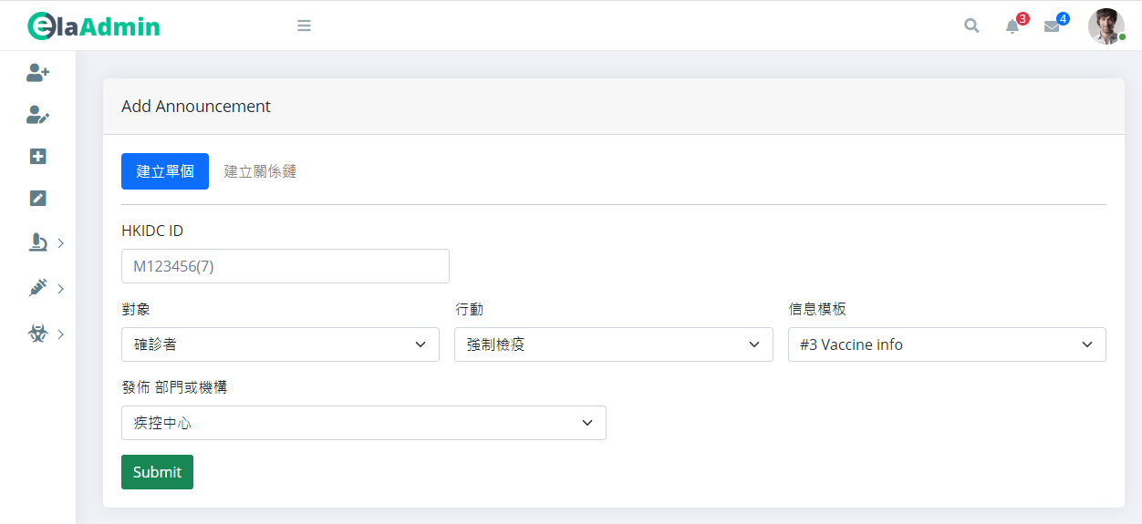

Slide 17
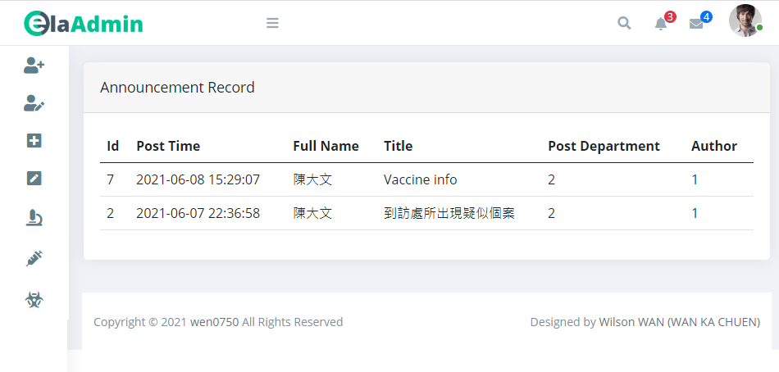

Slide 18
further enhancement
not enough setting function
security

Slide 19
~~ End ~~

